Slide 1
LECTURE 4
Iron blast furnace
EXTRACTIVE METALLURGY- FIRST CLASS
FERROUS EXTRACTIVE METALLURGY
The furnace used for iron production
is called blast furnace. The name of
the blast furnace is due to the fact that air is blown or "blasted" through the charge. It is composed of a hearth (fireplace at the bottom surface) and a pile (column) on the top, referring to Figure 1.

Slide 2
Hematite ore is added to the top of
EXTRACTIVE METALLURGY- FIRST CLASS
FERROUS EXTRACTIVE METALLURGY
the furnace along with coke and
limestone. Three reactions take place during this extraction:
1. Firstly, the coke (carbon) in the
blast furnace burns with the hot air to form carbon dioxide. This reaction produces the main source of heat in the furnace.

Slide 3
C + O2 → CO2 (Carbon dioxide)
EXTRACTIVE METALLURGY- FIRST CLASS
FERROUS EXTRACTIVE METALLURGY
The air for the blast furnace has to be
0_{C}
preheated to 500-1000 and
compressed to 200-300 KPa to burn
the necessary amount of coke to supply the required temperature for the reactions.
The coke burns
intensively
near
approximately 1700 °C. At
this

Slide 4
temperature, CO2 reacts immediately
EXTRACTIVE METALLURGY- FIRST CLASS
FERROUS EXTRACTIVE METALLURGY
with carbon to form CO:
C+ CO2 → 2CO (Carbon monoxide)
Now, Hematite;
2. Some of the Hematite (Fe2O3) reacts with carbon to form pure iron (along with carbon monoxide).

Slide 5
3C + Fe2O3 → 2Fe + 3CO (Carbon
EXTRACTIVE METALLURGY- FIRST CLASS
FERROUS EXTRACTIVE METALLURGY
monoxide)
However, most of Fe2O3 reacts with carbon monoxide, which is the main reducing agent of iron (iii) oxide. This produces pure iron and carbon dioxide.
Fe2O3 + 3CO → 2Fe + 3CO2
(Carbon dioxide)

Slide 6
Now, Limestone
EXTRACTIVE METALLURGY- FIRST CLASS
FERROUS EXTRACTIVE METALLURGY
3. In the blast furnace, limestone
(CaCO3) is used in pieces 5-10 cm in size that decomposed starting at
800 ⁰C as follows:
CaCO3 → CaO + CO2 (Carbon dioxide)
The main impurity found in iron ore is sand, or silicon dioxide SiO2. The

Slide 7
calcium oxide CaO reacts with silicon
EXTRACTIVE METALLURGY- FIRST CLASS
FERROUS EXTRACTIVE METALLURGY
dioxide to form calcium silicate:
CaO + SiO2 → CaSiO3
Calcium silicate CaSiO3 is also called slag. This is also tapped off at the bottom of the furnace. The slag floats above the iron because it’s lighter. So, the purpose of using limestone is to:

Slide 8
EXTRACTIVE METALLURGY- FIRST CLASS
FERROUS EXTRACTIVE METALLURGY
Collect the impurities in the molten
metal.
Protect the metal from oxidation by the furnace atmosphere.

Slide 9

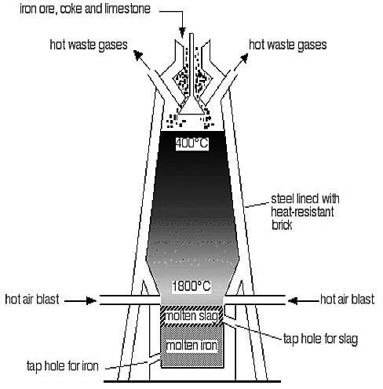
EXTRACTIVE METALLURGY- FIRST CLASS
FERROUS EXTRACTIVE METALLURGY
Figure 1: extraction.
The blast
furnace
for iron

